Slide 1





Decentralized Identity Verification: A Blockchain Approach
Inter Disciplinary Project
2023-24

Slide 2
Y.V. Pranay Kumar
211FA19002
Meet Our Team
Ch. Kalyan Chowdhary
211FA19066
Our team members who have contributed significantly to the "Decentralized Identity Verification" project. Our team's collective efforts, dedication, and passion have made this project possible and successful.
P. Rahul Sai Pavan
211FA19068
S. Veera Babu
221LA19001

Slide 3



What is Identity Verification?
Identity verification is the process of confirming that someone is who they claim to be. This involves verifying the identity information provided by an individual, such as their name, date of birth, and other personal details, against reliable and trusted sources of information.
Physical identity documents such as passports, driver's licenses, and national ID cards
Knowledge-based verification such as answering security questions or providing information that only the individual would know
Biometric verification such as fingerprint, facial recognition, and iris scanning

Slide 4


Purpose of Identity Verification
Identity verification is used in a variety of industries, from banking and finance to healthcare and government. It is also essential for online transactions and e-commerce, where the risk of fraud is high.
Protect against unauthorized access to sensitive information
Prevent fraudulent transactions and financial crimes

Slide 5
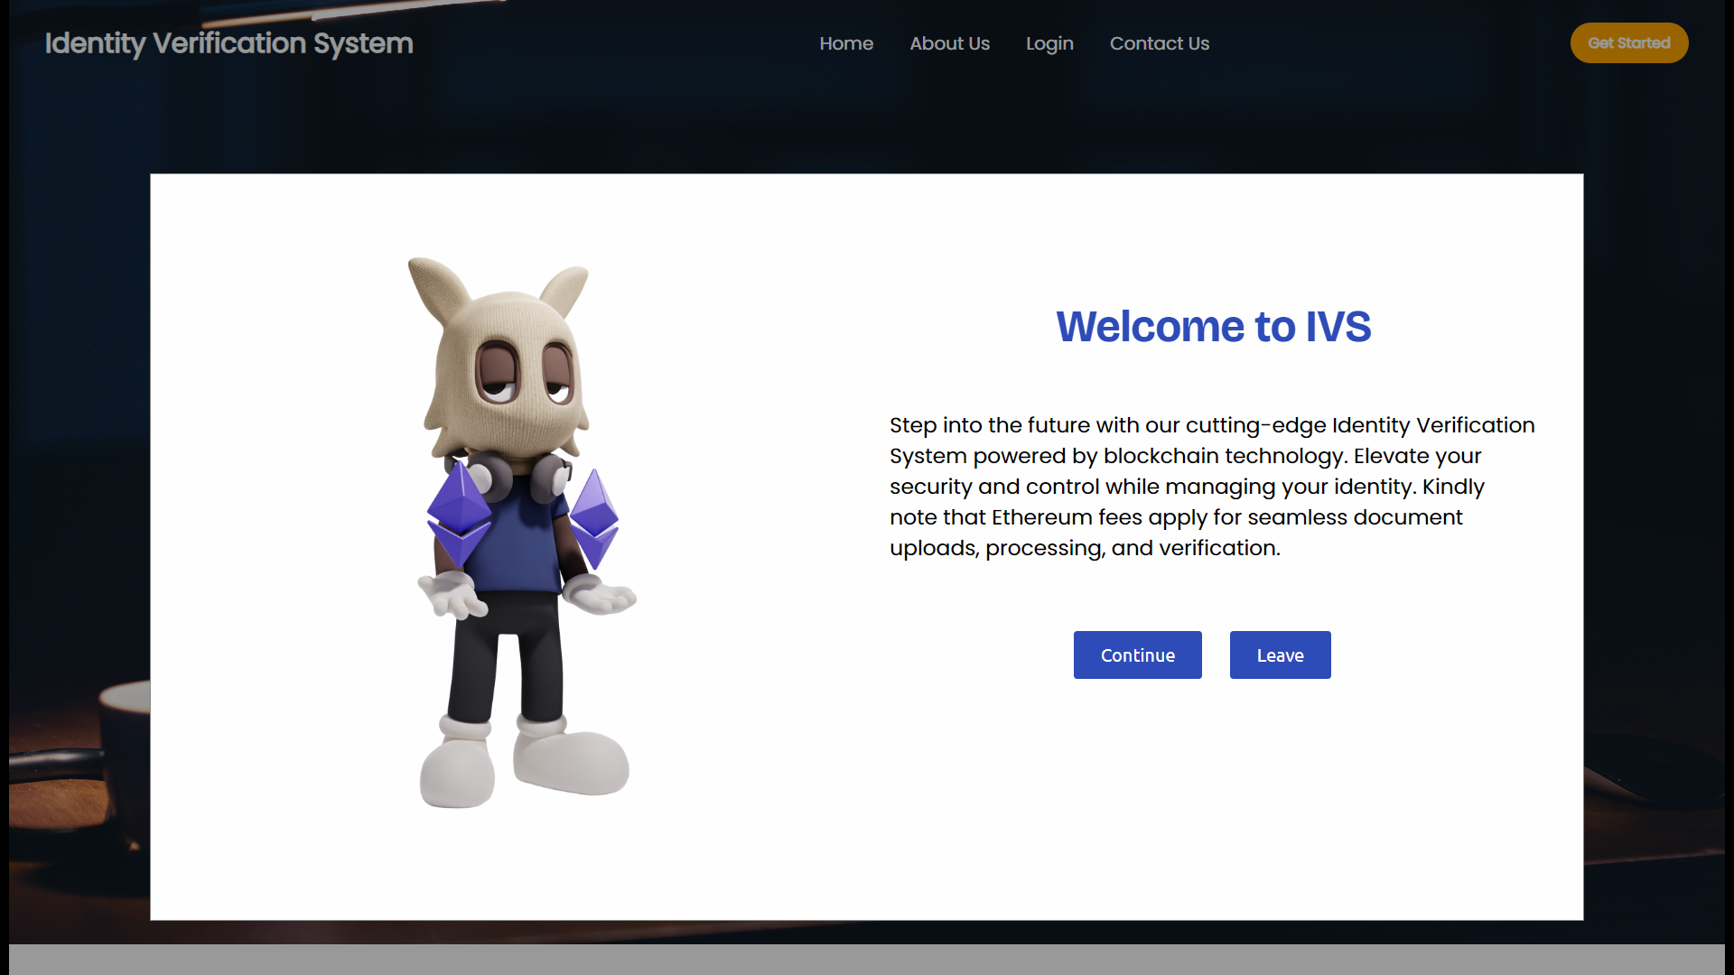
Project Implementation

Slide 6


Slide 7
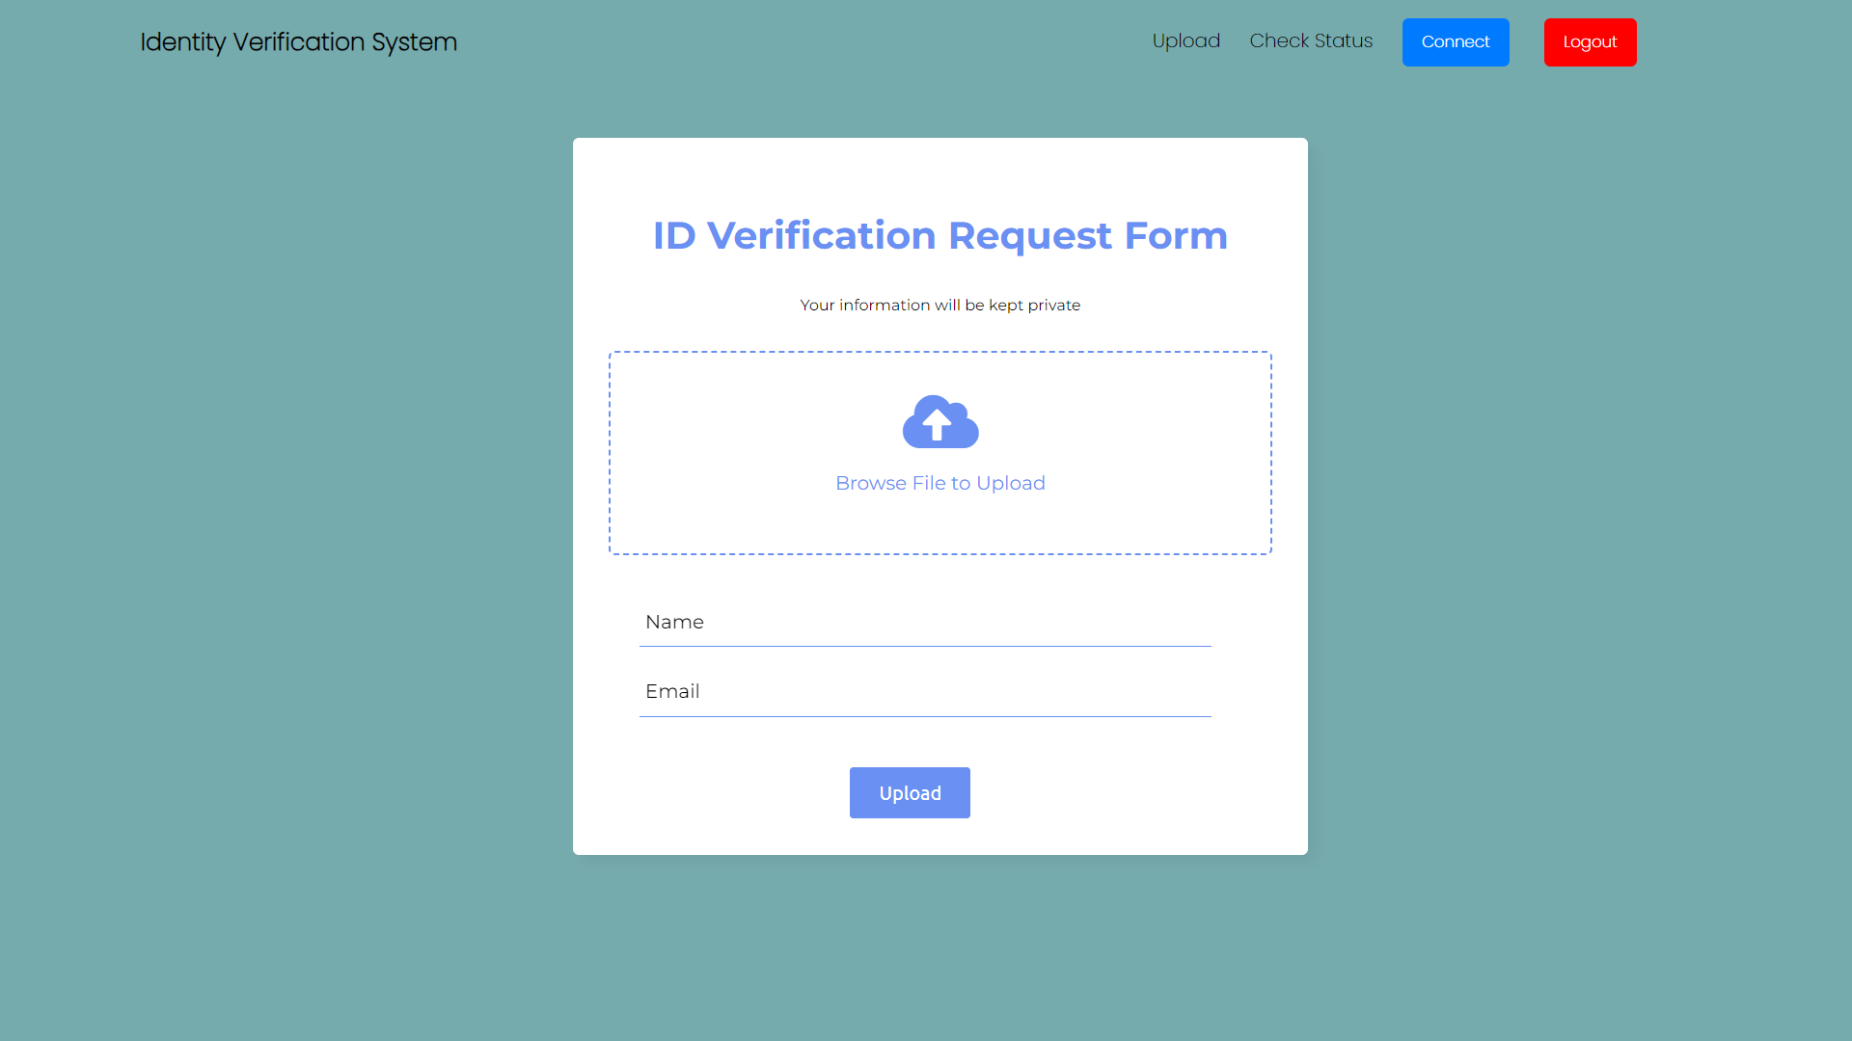

Slide 8
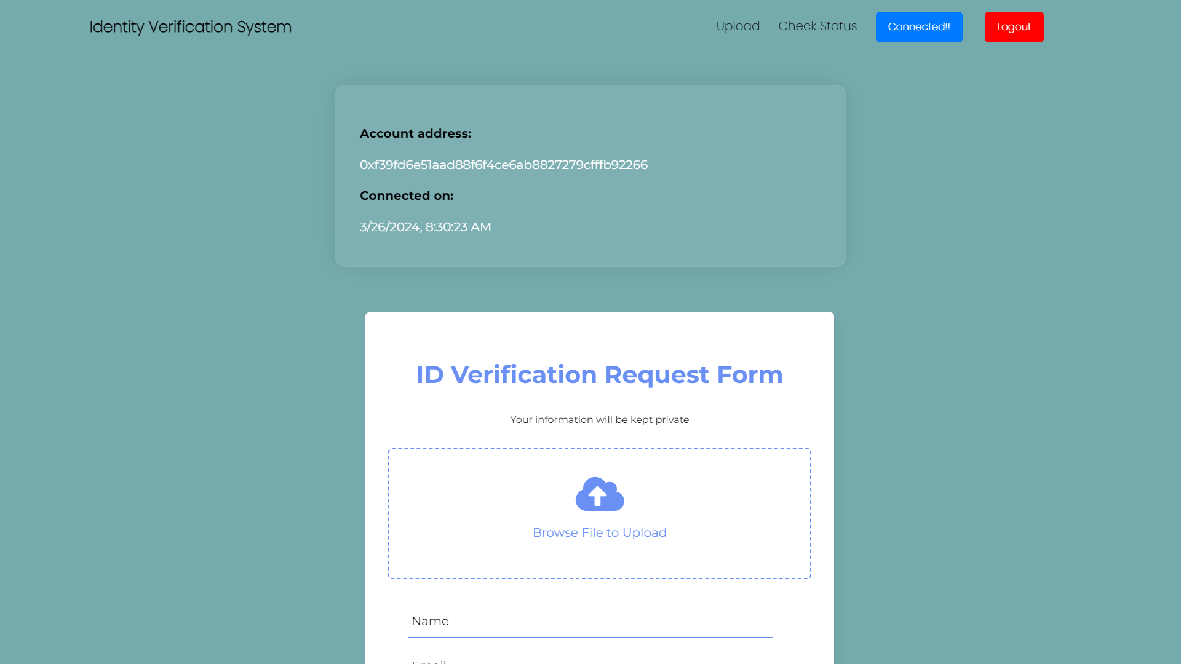

Slide 9
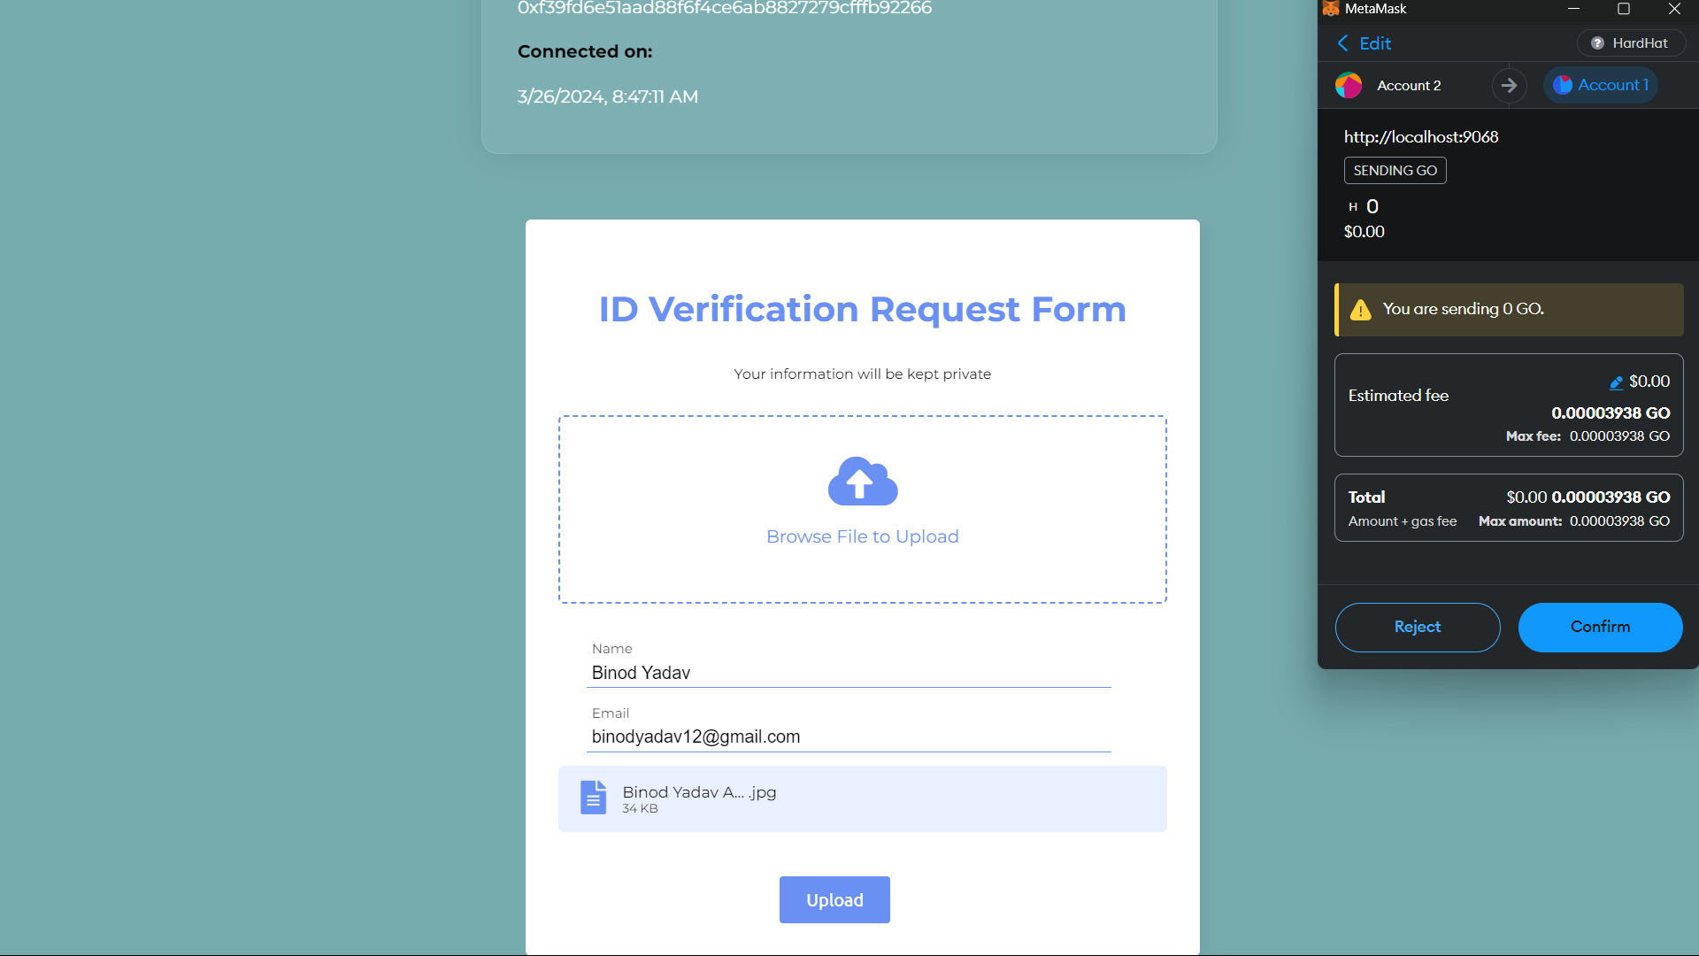

Slide 10
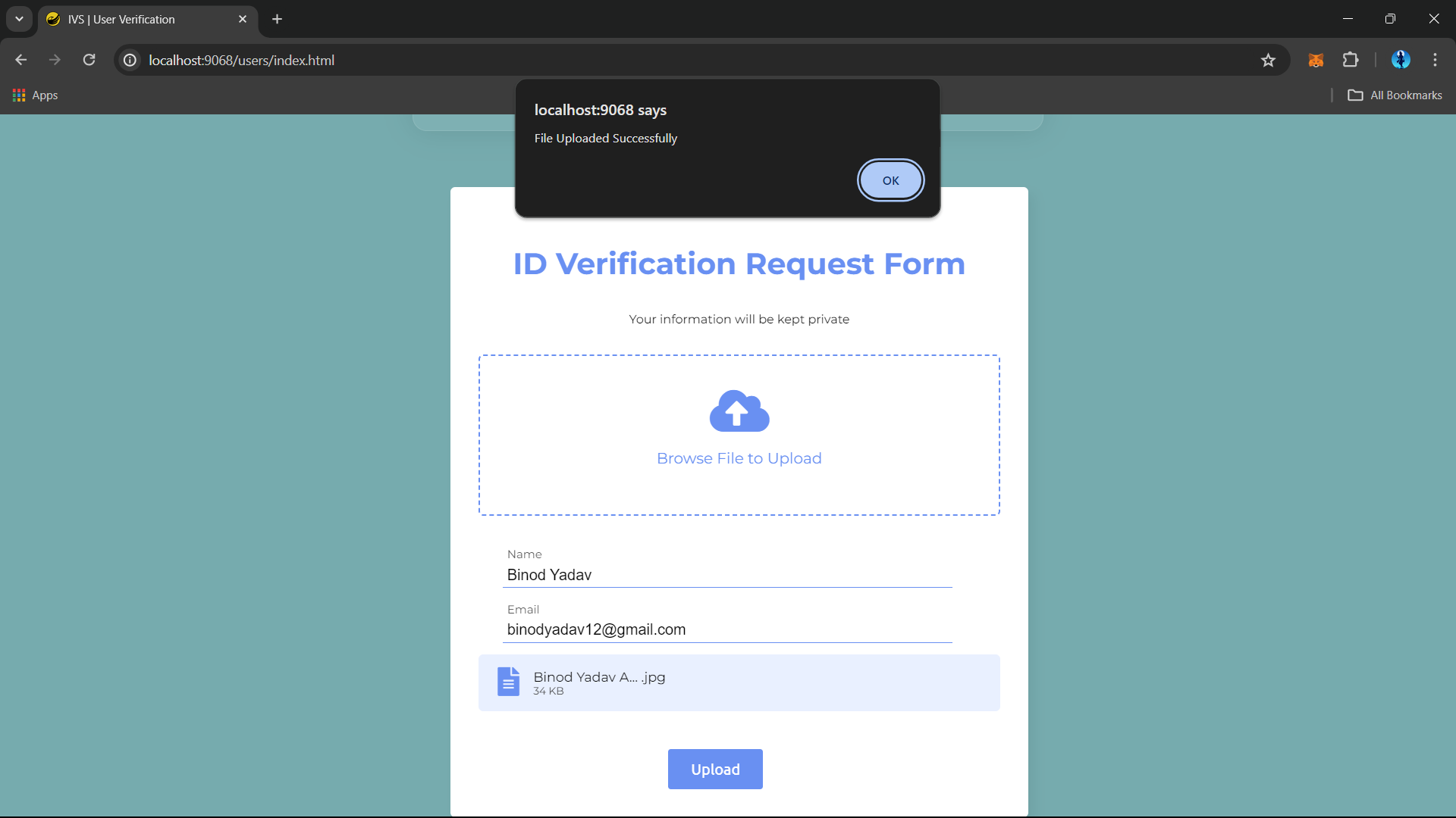

Slide 11
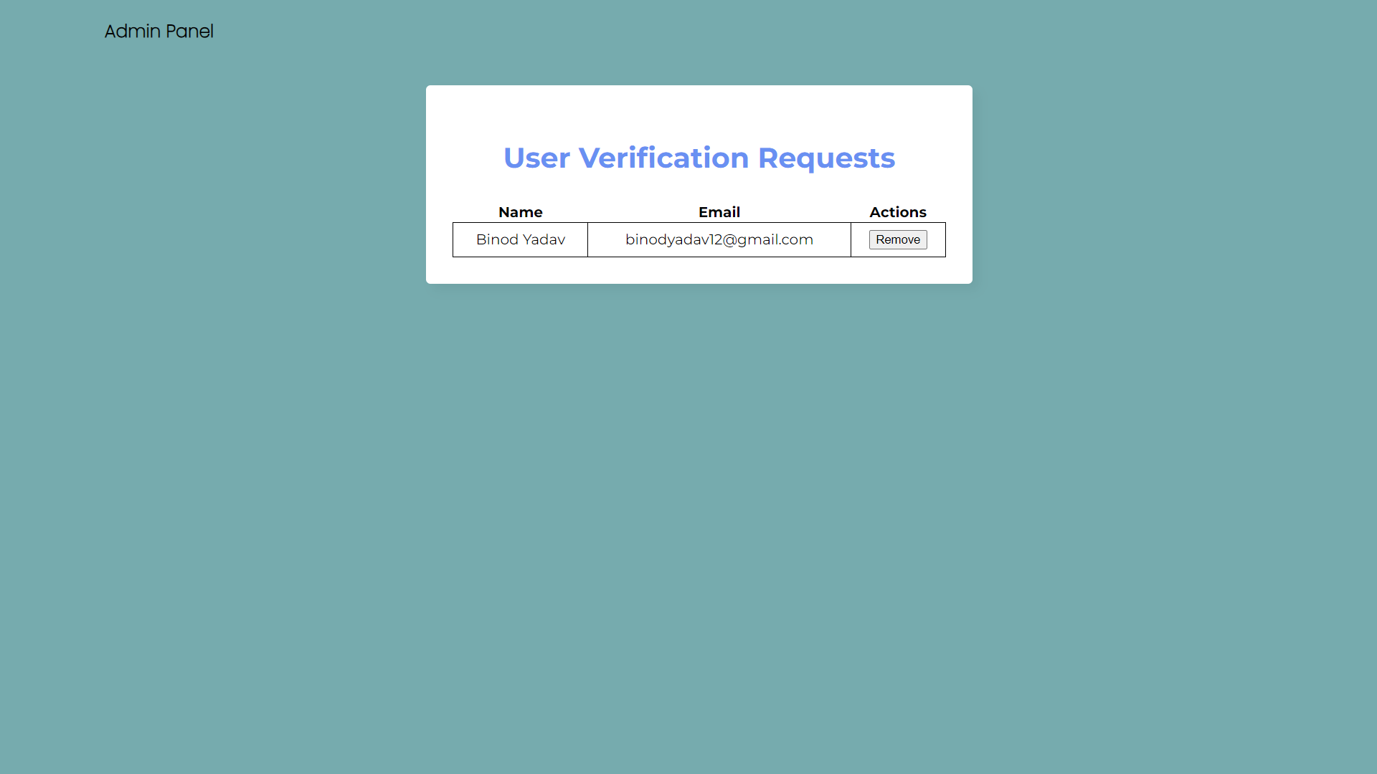

Slide 12
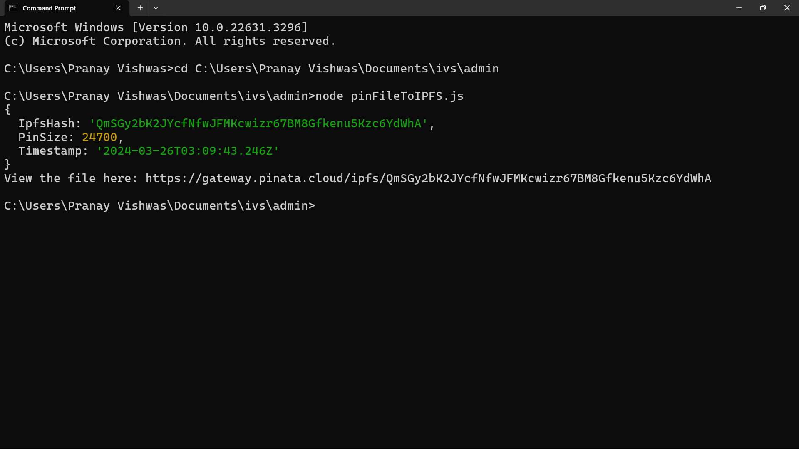

Slide 13


Slide 14
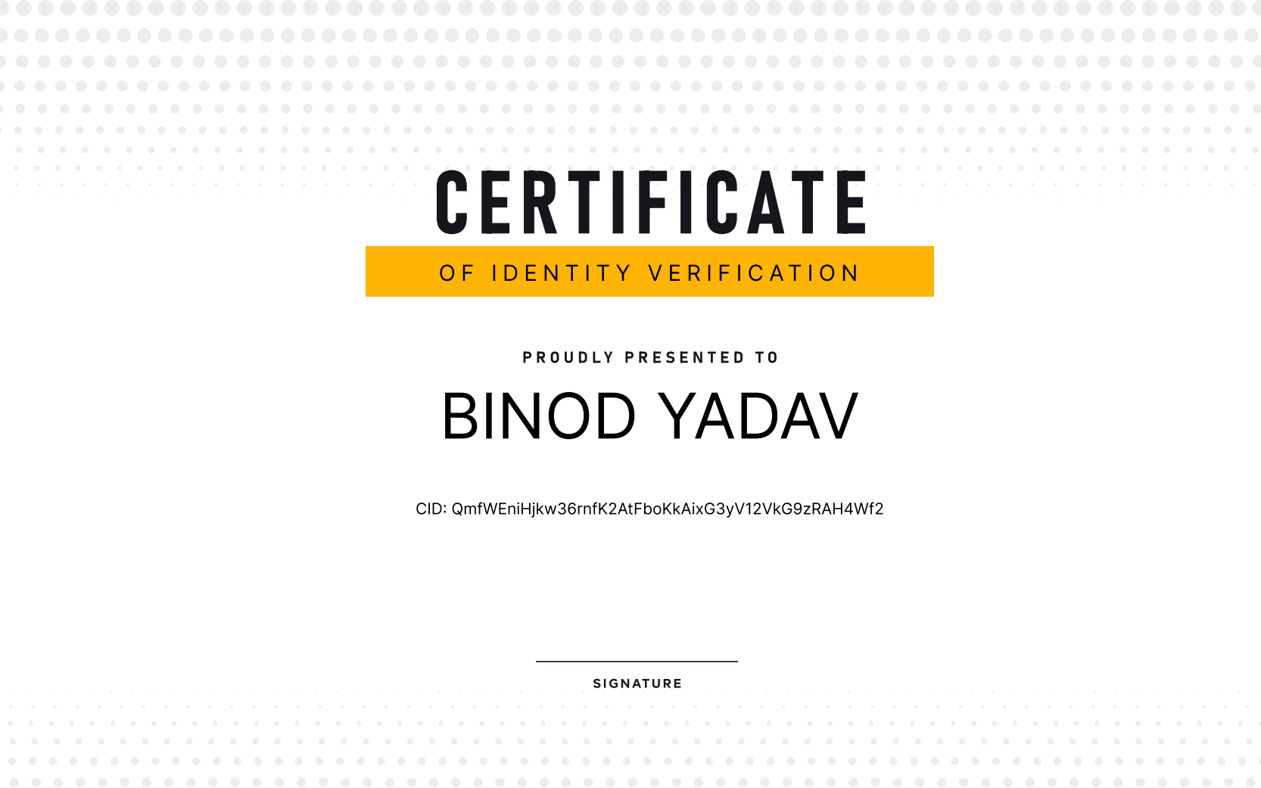

Slide 15

Thank You

